Slide 1
Multidisciplinary and integrative approach
to cancer patients and diseases
Elio G. Rossi
Clinic of Complementary Medicine and diet in oncology –
AUSL Tuscany North West – Lucca (Italy)

Slide 2
Use of Complementary medicine by cancer patients: Epidemiological Data
In the United States, approximately 38% of adults and 12% of children use some form of Complementary and/or Integrative therapies (NCCAM. The Use of Complementary and Alternative Medicine in the United States. December 2008)
More in detail, a European multicenter study reported that 32.2% of people are treated with complementary therapies, with percentages ranging from 5% to 74.8%. (A. Molassiotis, P. Fernadez-Ortega, D. Pud, G. Ozden, J.A. Scott, V. Panteli, A. Margulies, M. Browall, M. Magri, S. Selvekerova, E. Madsen, L. Milovics, I. Brunys, G. Gudmundsdottir, S. Humerston, A.M.A. Ahmad, N. Platin, N. Kearney, E. Patiraki,, Use of complementary and alternative medicine in cancer patients: a European survey. Ann Oncol. 2005)
Furthermore, an estimated 40% of cancer patients in Europe use these therapies in addition to conventional cancer therapies. (Frass M, Strassl RP, Friehs H,Müllner M, Kundi M, Kaye AD. Use and acceptance of complementary and alternative medicineamong the general population and medical personnel: a systematic review.OchsnerJ. 2012, Spring;12(1):45-56).
According to a study conducted on 4,349 French patients 2 years after cancer diagnosis, 16.4% used complementary medicine, and especially homeopathy (64.0%), acupuncture (22.1%), osteopathy (15.1%), phytotherapy (8.1%), and nutrition (7.3%) (Sarradon-Eck A, Bouhnik AD, Rey D, Bendiane MK, Huiart L, Peretti-Watel P. Use of non-conventional medicine two years after cancer diagnosis in France: evidence from the VICAN survey. J Cancer Surviv. 2017 Aug;11(4):421-430).

Slide 3
2009-2010
2011 -2014
Participation in European Partnership Action Against Cancer (EPAAC) Scientific evidence and European mapping of I.O. services
2016 -2018
International Congresses "Integrated Oncology" Florence, November 2016 and March 2018
2015
2018
Publication and dissemination of the regional brochure promoted by ITT "Complementary medicines for the oncological patient". Health Research Announcement 2018 "Line 3.4 - Research on complementary and integrated medicine"
DGR n. 418/2015 "Integration of complementary medicine in the oncology network of the Tuscan Cancer Institute -
Creation of regional working group of oncologists and CM experts and review of literature on oncology and CM
Publication of the book "CMs for the cancer patient".
Institutionalisation of regional working group “Integrative oncology”
Signing of the Memorandum of Understanding of the Region of Toscany with Memorial Sloan Kettering Cancer Center of New York - USA

Slide 4
Regional Diagnostic, therapeutic and care pathways (PDTA) Complementary medicine in the PDTA - Breast cancer PDTA - Integrated oncology
Decreto dirigenziale n. 38 del 19.3.2019
Decreto dirigenziale n. 2986 del 26.2.21 (Revisione)
Decreto dirigenziale n.19664 del 11.11.2021

Slide 5
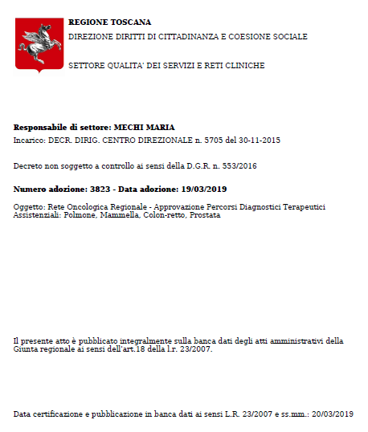
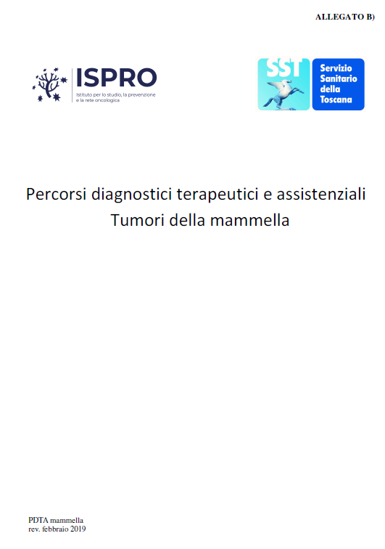
PDTA* Breast cancer – Region of Tuscany Decreto dirigenziale n. 38 DEL 19.3.2019

Slide 6
PDTA* Breast cancer (Final version) – TuscanyRegion DECRETO DIRIGENZIALE n.2986/2021

Slide 7
First oncological examination
This is scheduled directly at the GOM, preferably within a week of the multidisciplinary discussion. The patient is presented with the treatment proposal formulated at the GOM, which also includes the use of integrative complementary medicine to treat the adverse effects of chemotherapy such as nausea, vomiting and asthenia.
The Multidisciplinary Oncology Group (MOG)
These professionals, depending on the patients’ needs, must be supported by other professionals such as: plastic surgeon, psycho-oncologist, geneticist, nuclear doctor, physiotherapist, integrative medicine doctor (acupuncturist, phytotherapist, homeopath), etc.
Access to the Radiotherapy Centre
The personalized treatment plan will also take into account the use of integrative medicine treatment to control the adverse effects of radiotherapy such as mucositis, xerostomia and radiodermatitis.

Slide 8
INTEGRATIVE MEDICINE VISIT
Integrative medicine visit: after the choice of treatment by the GOM, the patient is referred to acupuncture, phytotherapy and homeopathy facilities based on the possible side effects of the treatment, taking into account the patient's liking and according to the regional guidelines on integrative medicine in cancer care. (Page 47)
FURTHER SUPPORT PATHWAYS FOR PATIENTS WITH BREAST CANCER
If the assessment shows signs/symptoms indicative of psychopathological distress requiring drug therapy, the clinician must inform the medical team, …… It may also refer the patient to integrative medicine clinics for the treatment of mild mood and sleep disorders. (pp. 54-55)

Slide 9
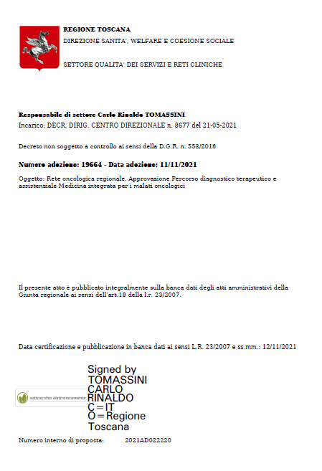
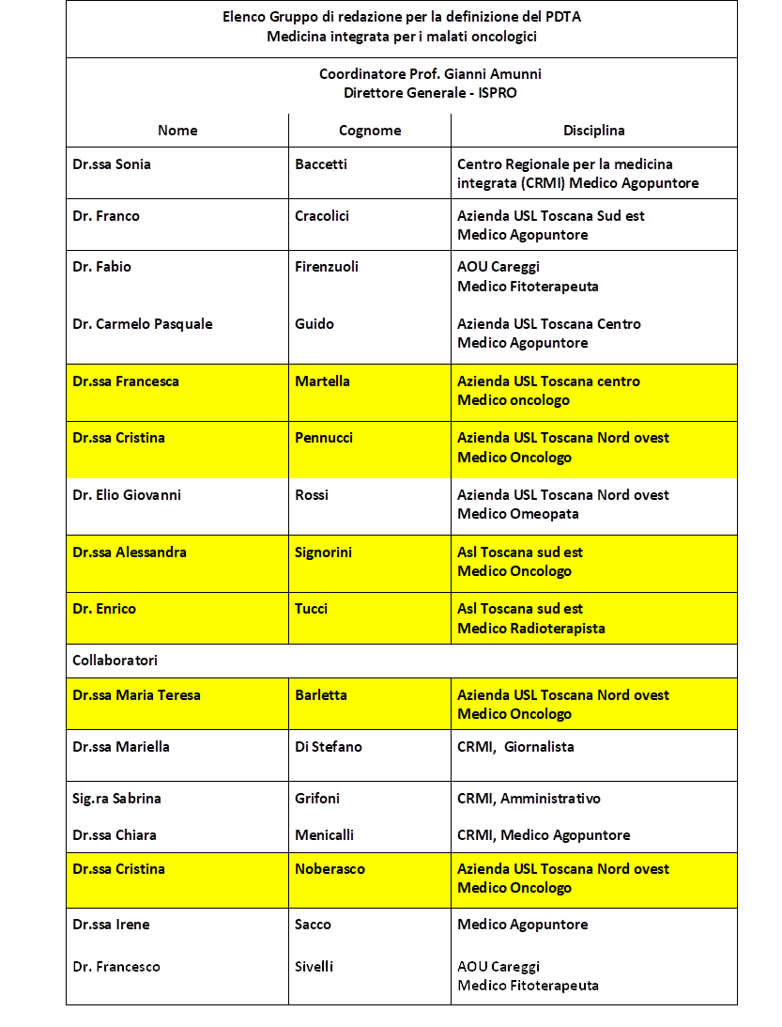
Decreto dirigenziale n. 19664 del 11.11.2021
Diagnostic, therapeutic and care pathways
PDTA - Integrated medicine for cancer patients

Slide 10
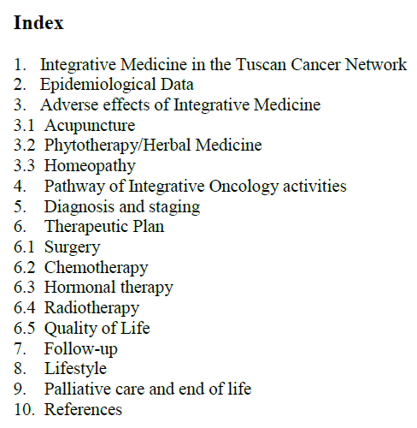
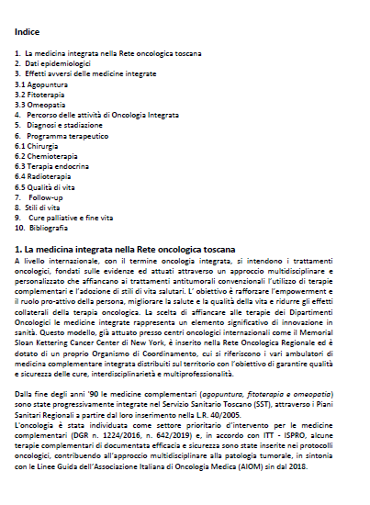
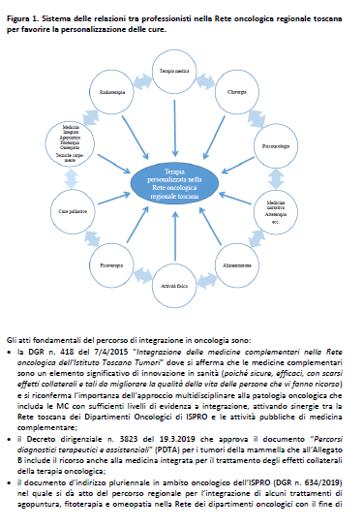

Slide 11
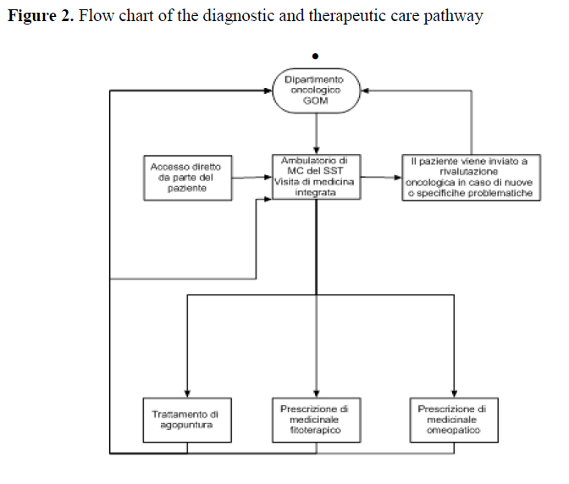

Slide 12
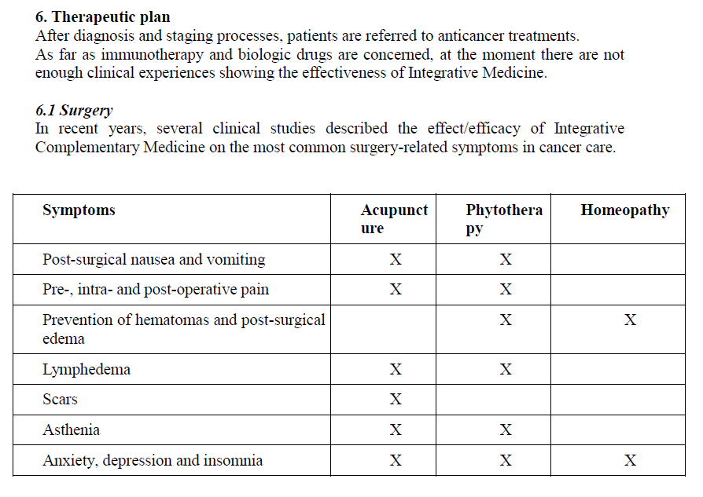

Slide 13
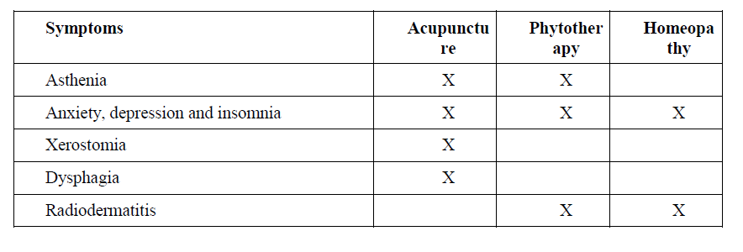
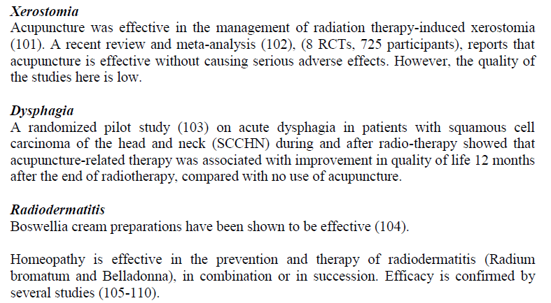

Slide 15
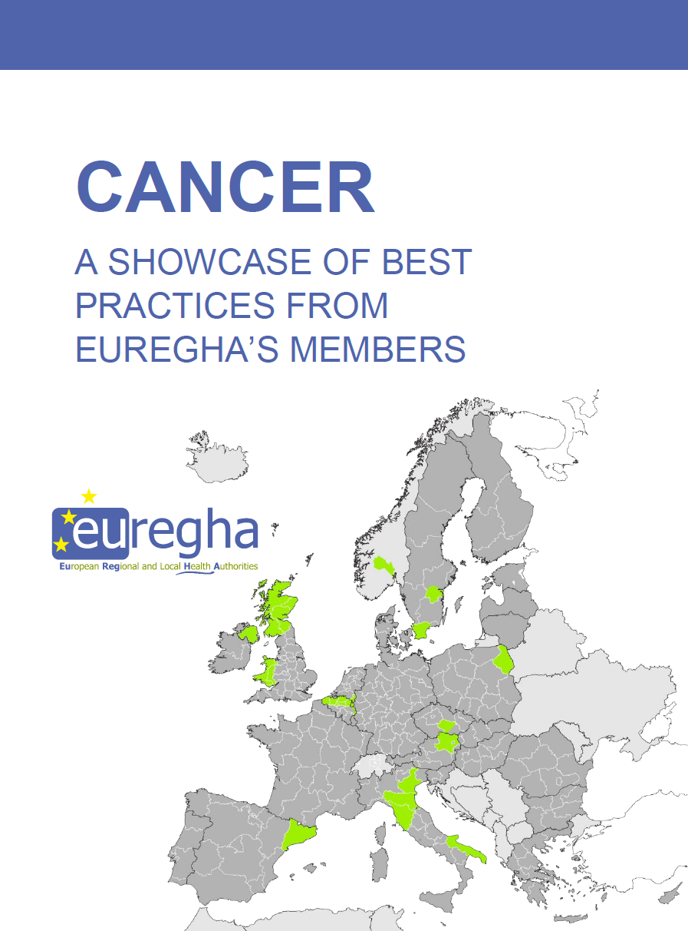
Una vetrina di buone pratiche sul cancro presentata alla Commissione e al Parlamento Europeo dai membri di EUREGHA

Slide 16
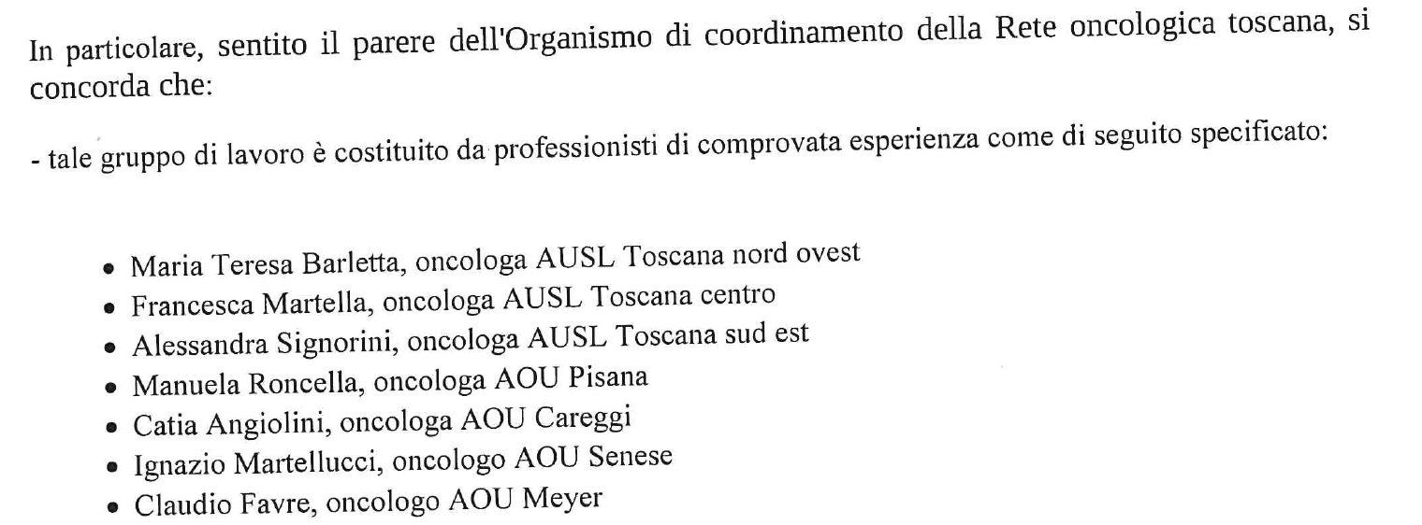
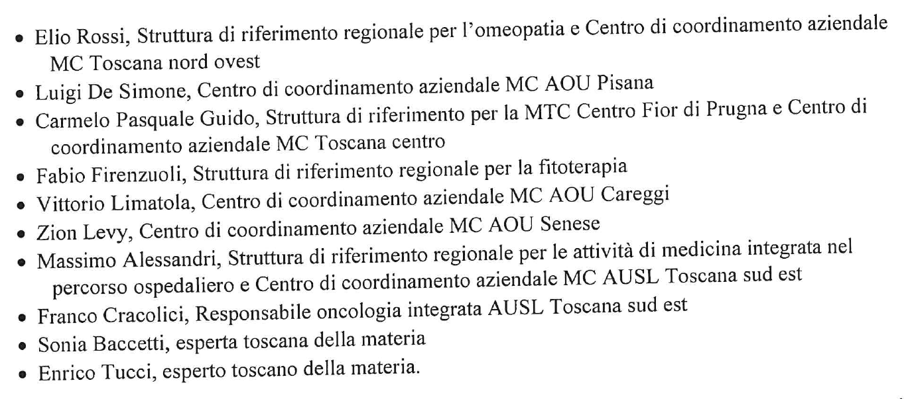
Integrazione del nuovo gruppo di lavoro regionale di oncologia integrata (nota ISPRO del 29.3.22)

Slide 17
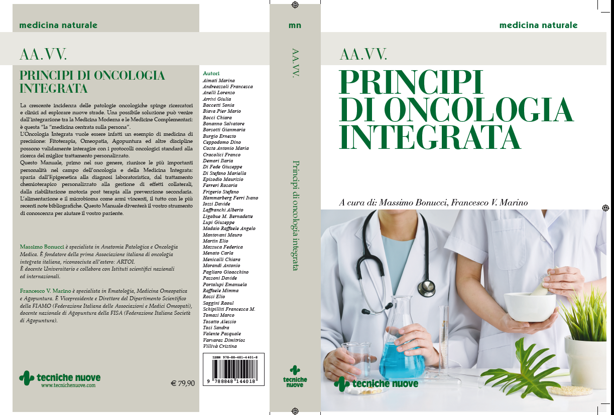
M. Bonucci – F. Marino
'Principi di oncologia integrata'
ARTOI (Associazione Ricerca Terapie Oncologia Integrata)
in collaborazione con il Gruppo nazionale multidisciplinare "6 luglio"

Slide 18
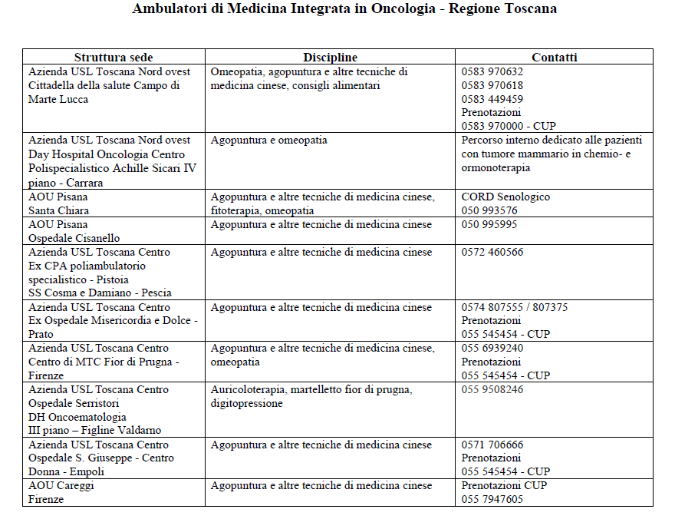
Clinics of Integrative medicine in oncology in Public Health System of Tuscany Region

Slide 19
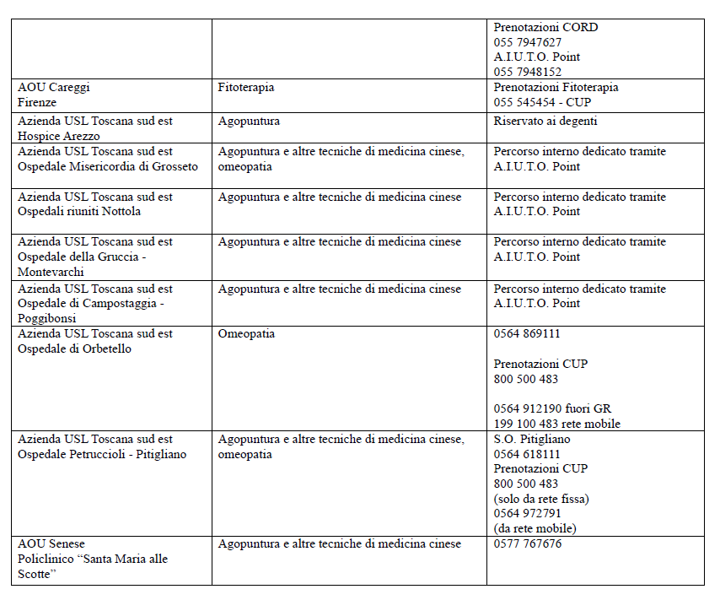

Slide 20
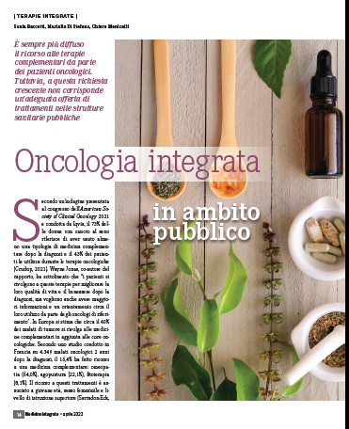
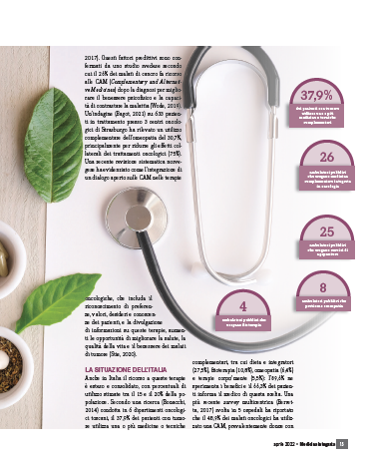
«Medicina integrata» n. 2 Aprile 2022 Tecniche Nuove Edizioni, Milano

Slide 21
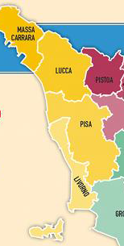
Integrative oncology clinics of the AUSL Tuscany North West
Dott.ssa Muttini
Dott.ssa Pennucci
Ambulatorio Oncologia integrata
(Ex DGR 1446/19 All. B)
Dott. Rossi
Dott.ssa Noberasco
Ambulatorio Medicine complementari e alimentazione
in oncologia
Dott.ssa Cidin Dott.ssa Maceri
Dott. De Simone
Ambulatorio di oncologia integrata apparato genitale femminile
Dott. Bosco
Dott. De Simone
Ambulatorio Oncologia integrata neoplasie mammarie
(Dott. Rodaro)
Ambulatorio di fitoterapia in Oncologia integrata
(Ex DGR 1446/19 All. B)

Slide 22
SAVE THE DATE

Slide 23
Thanks for your attention!
eliogiovanni.rossi@uslnordovest.toscana.it

